Slide 1
Salesforce Interview
Abdelbasset WARAKI

Slide 2
Template contents
Troubleshoot
Use case & Problematique
Architecture
Demo
Next Step

Slide 3
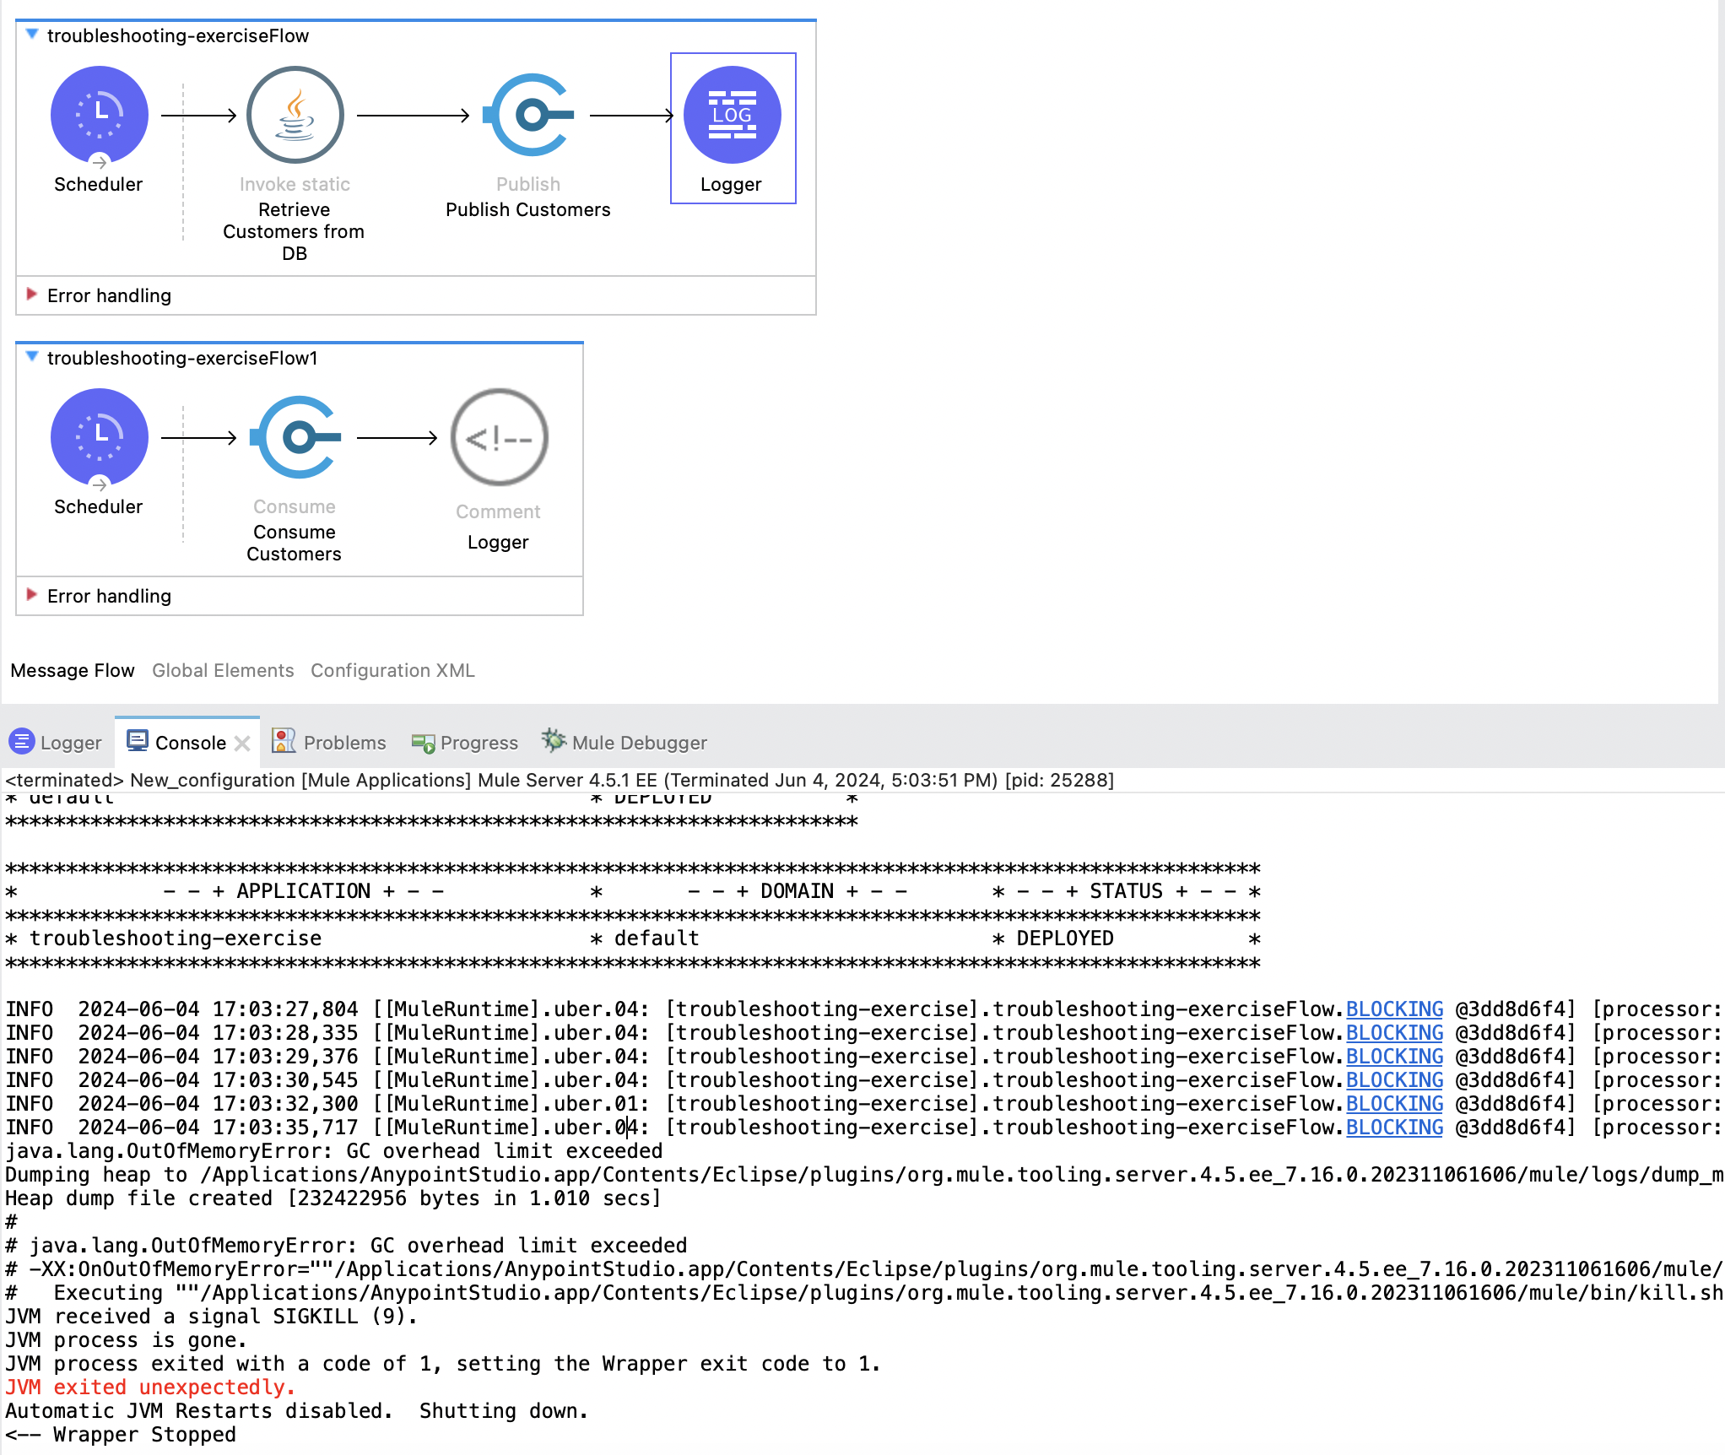
Error OutOfMemory
6 Messages Published to the queue

Slide 4
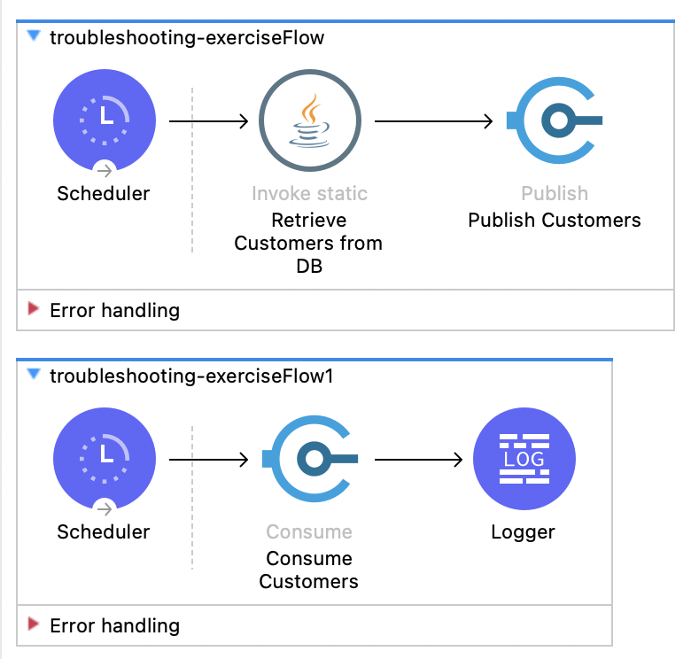
Troubleshoot
Scheduler
Java Connector
Publisher & Consumer
Notes:
First when I start by
When I did go to more details

Slide 5
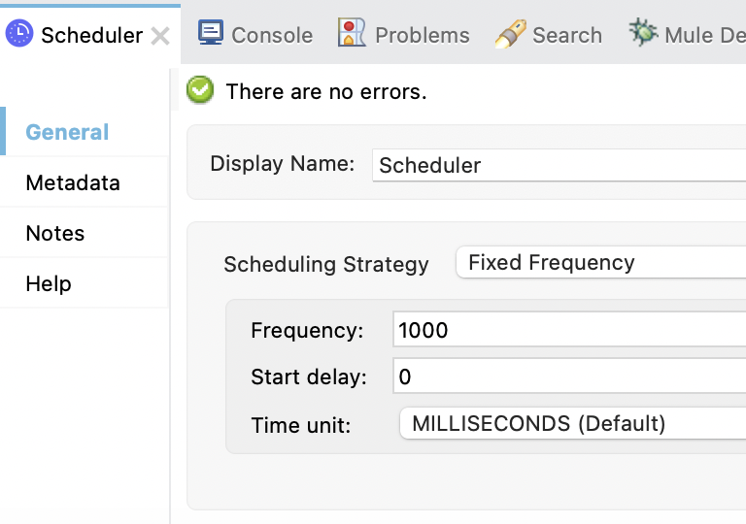
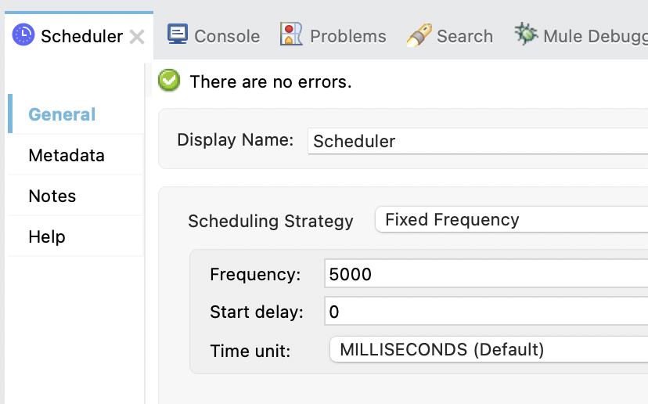
Troubleshoot
Scheduler
Java Connector
Publisher & Consumer
Notes:
First when I start by
When I did go to more details

Slide 6
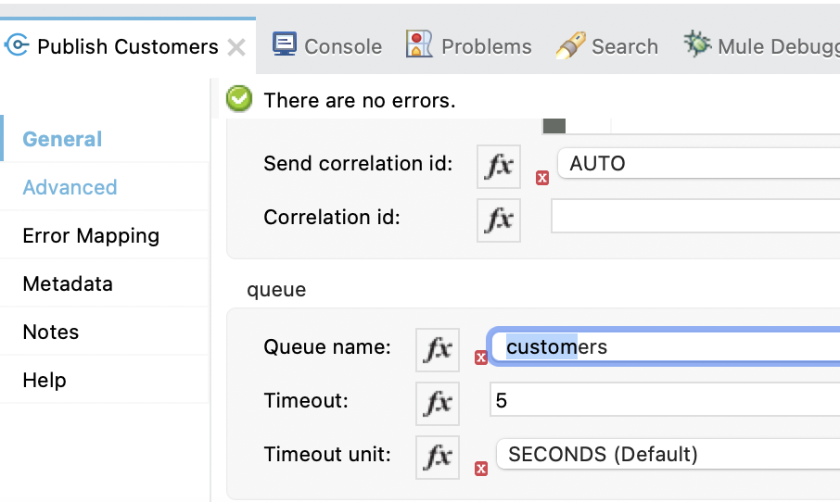
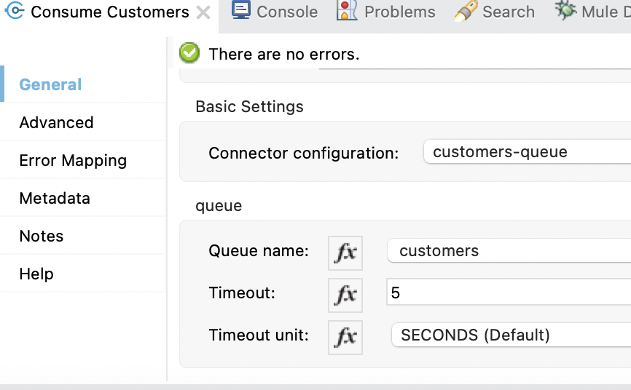
Troubleshoot
Scheduler
Java Connector
Publisher & Consumer
Notes:
First when I start by
When I did go to more details

Slide 7
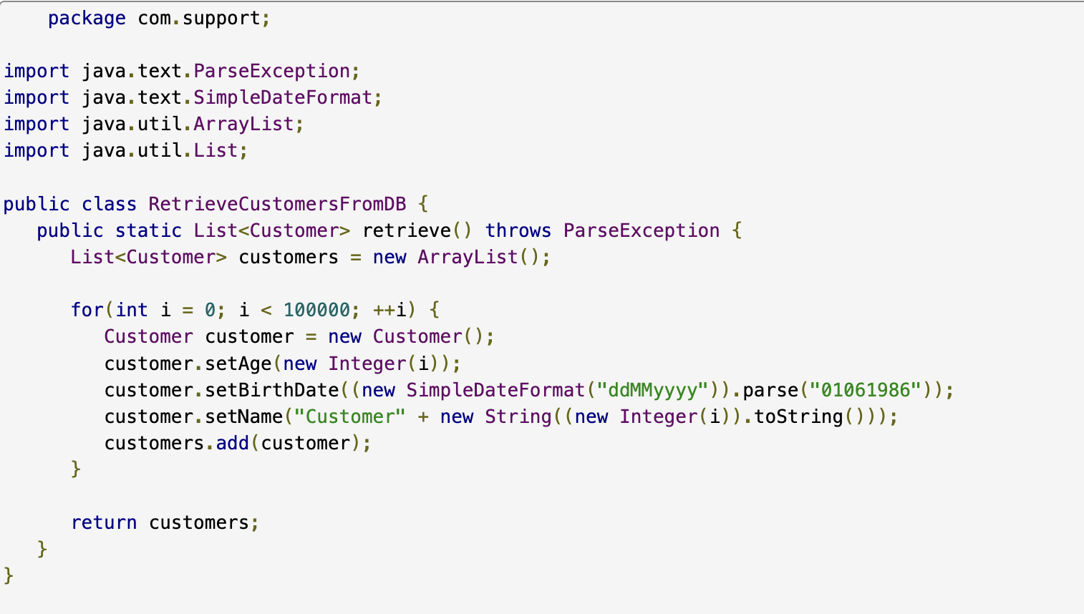
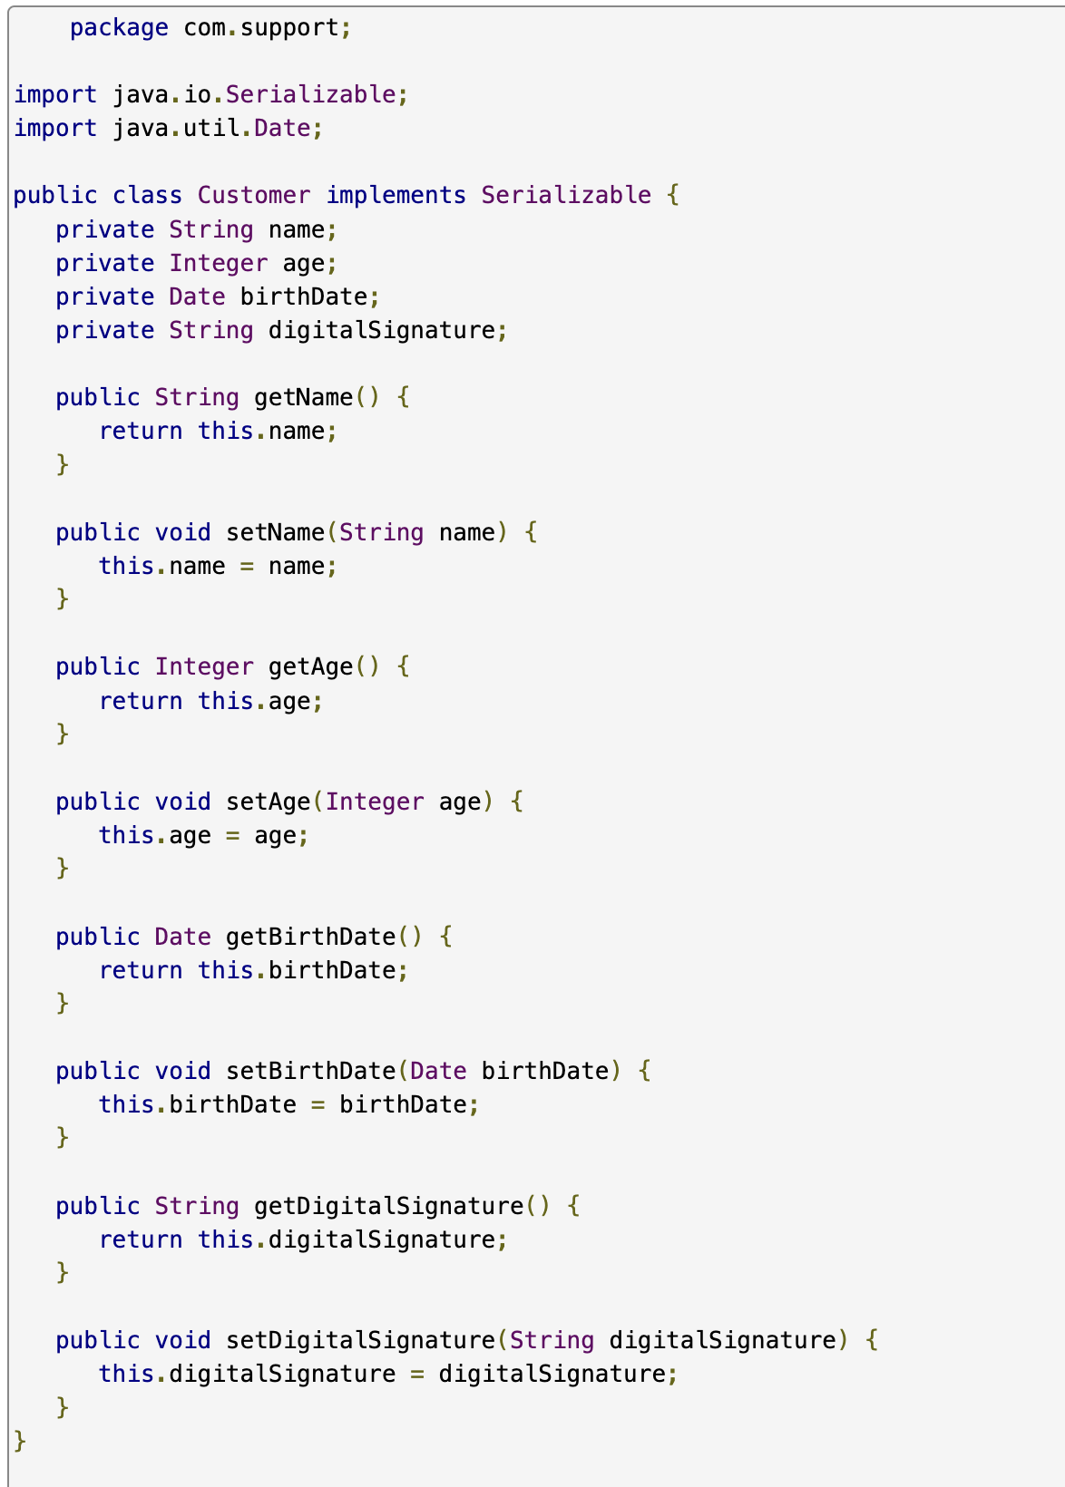
Classes

Slide 8
My propositions
Aligning Scheduler Frequencies of Publisher/Consumer
Use Persistent queue
Compress and Decompress Connectors

Slide 9
Synchronize Schedulers Frequencies
This solution will be effective and won't interrupt our flow.
Notes:
First when I start by
When I did go to more details

Slide 10
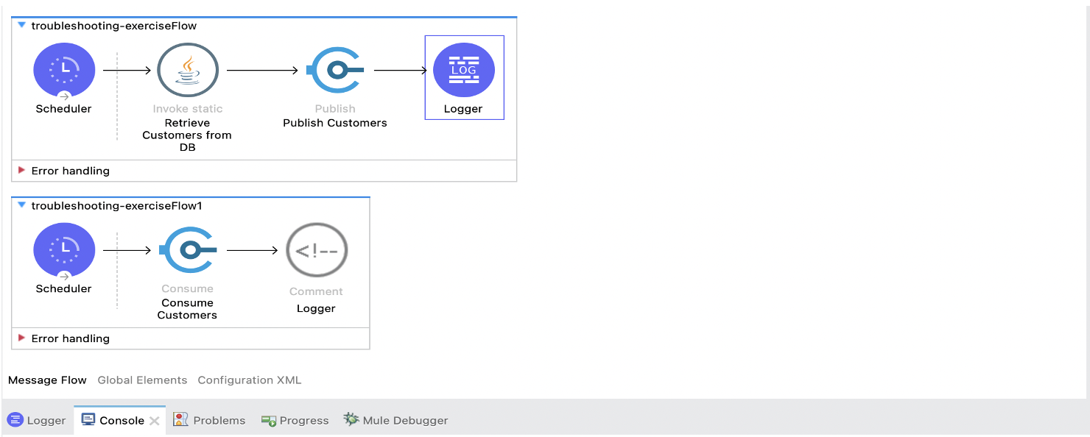
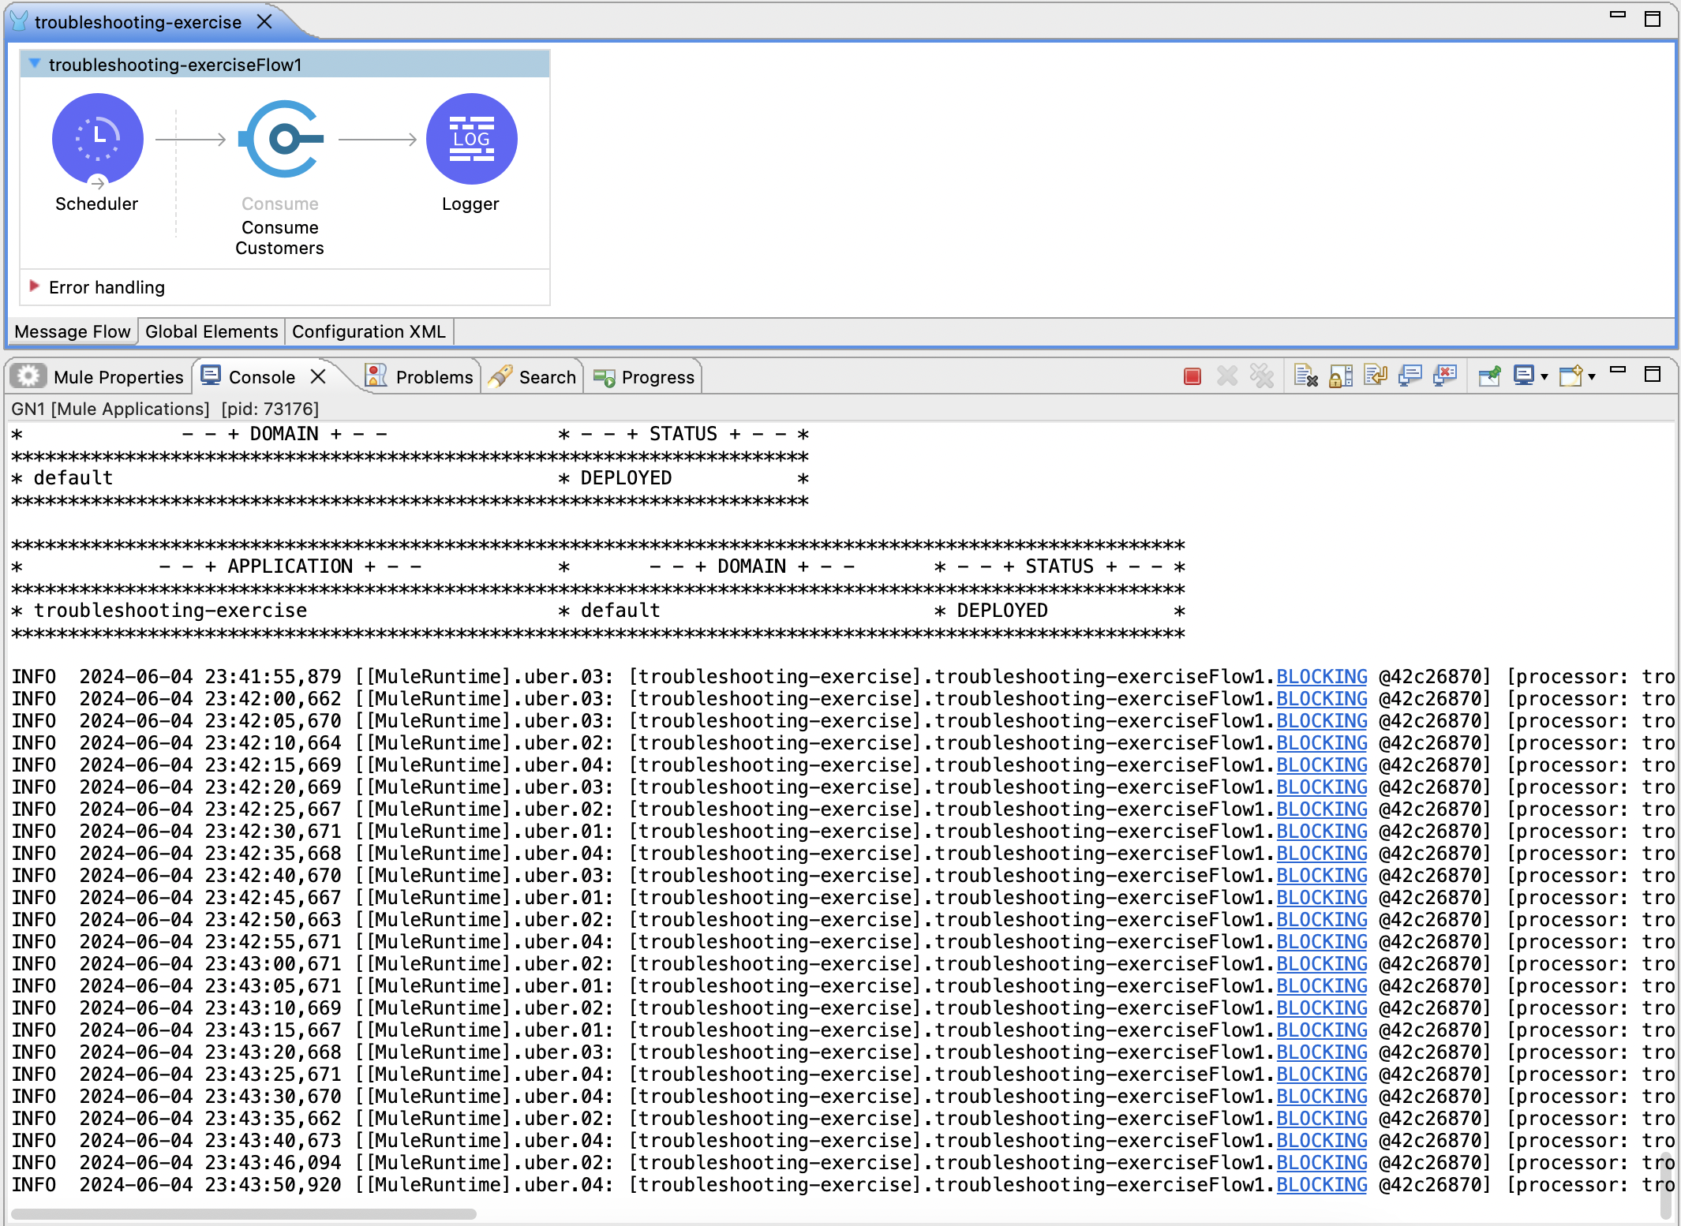
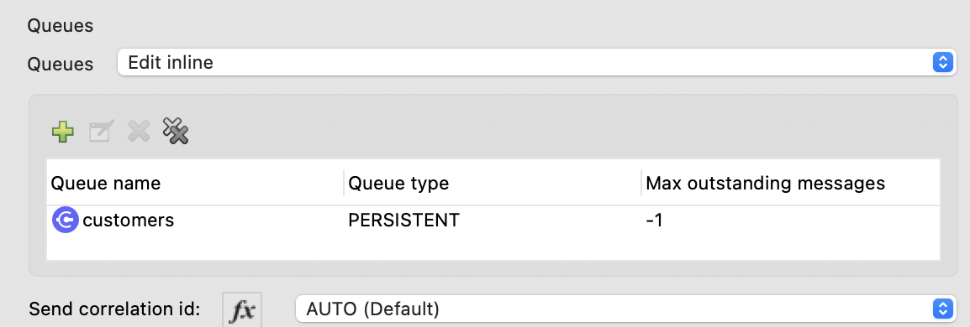
Using Presistent Queue

Slide 11
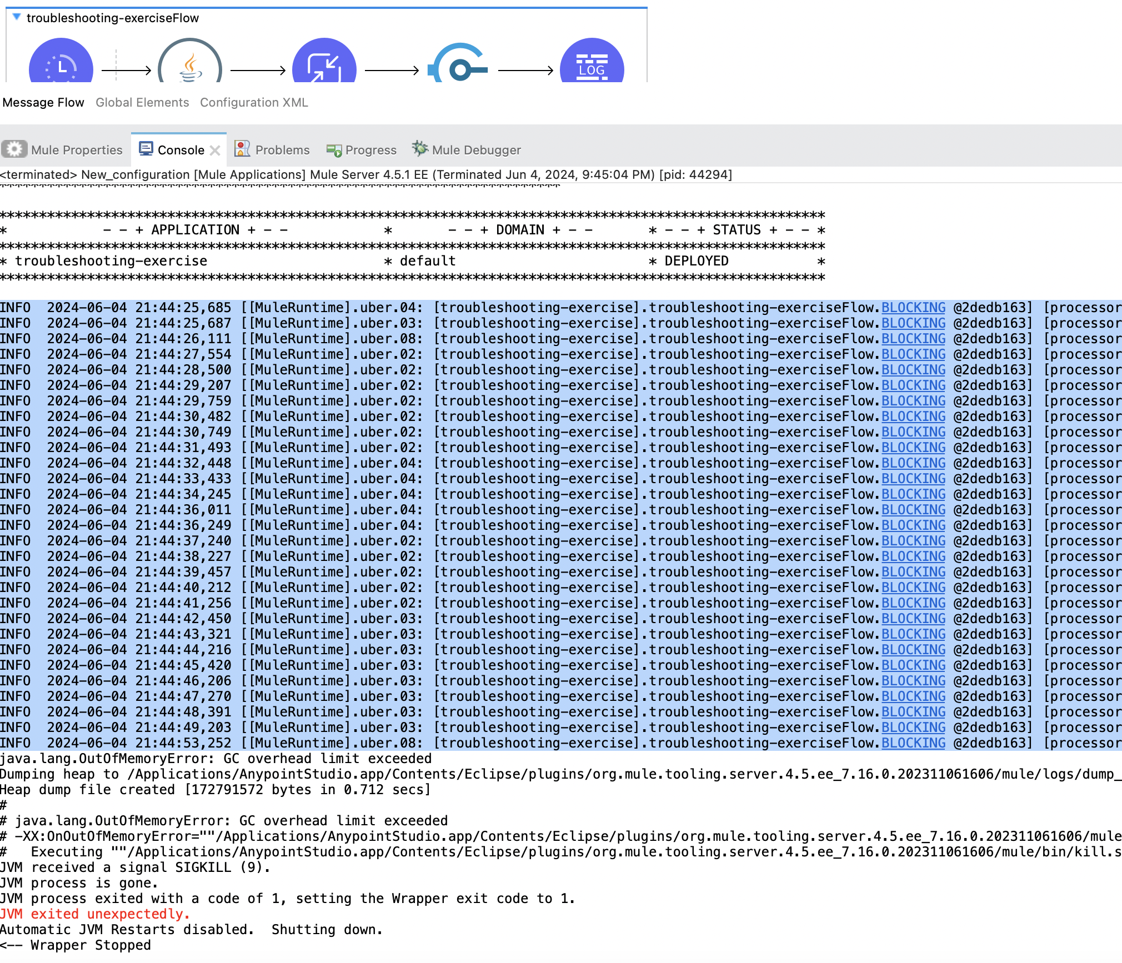
Compress / Decompress
30 Messages Published to the queue
Instead of 6 max messages

Slide 12
Template contents
Troubleshoot
Use case & Problematique
Architecture
Demo
Next Step

Slide 13


Use case & Problem Statement
S-Mark Global
S-mark, a multinational corporation, recently acquired (Media-FR) => S-mark France
Global
Germany
France
England
USA
S-Mark France
S-Mark Germany
Problems :
S-Mark England
S-Mark USA
Mass Synchronization to S-Mark Global
Ensure Daily Synchronization
Limited resource SF
Notes:
S-mark, a multinational corporation, recently acquired (Media-FR) “ S-mark France “, a subsidiary, creating a need to synchronize data between their Salesforce organizations for France (S-mark-France) and the global market (S-mark-Global). With limited resources such as storage and memory, it was critical to implement an efficient archiving model to maintain high performance and data quality. Leveraging Mulesoft's integration capabilities, we developed a robust system to integrate and synchronize these Salesforce orgs while utilizing MongoDB for efficient data archiving and reporting. This solution ensures daily synchronization, optimized resource usage, and archived data.

Slide 14
Template contents
Troubleshoot
Use case & Problematique
Architecture
Demo
Next Step

Slide 15

API led Connectivity
API-led connectivity a modern methodology to integrate applications and data through reusable APIs. It replaces the complex point-to-point integration style to enable a more flexible, scalable and agile architecture.
This layer is composed of APIs that enable the easy consumption by third parties.
Experience layer
User Gateway
UserGateway-xapi
APIs responsible to fetch, orchestrate and propagate data from/to core systems.
Process layer
MDB Archivage
MDB-Archivage-PAPI
SF Operations
SF-Operations-PAPI
SF Synchro
SF-Synchro-PAPI
System layer
MongoDB
MongoDB-SAPI
Salesforce Global
Salesforce-Global-SAPI
Salesforce France
Salesforce-France-SAPI
APIs that connect directly with core systems, providing a point of access, abstracting system’s complexity.

Slide 16


API led Connectivity
Experience layer
User Gateway
UserGateway-xapi
Process layer
MDB Archivage
MDB-Archivage-PAPI
SF Operations
SF-Operations-PAPI
SF Synchro
SF-Synchro-PAPI
System layer
MongoDB
MongoDB-SAPI
Salesforce Global
Salesforce-Global-SAPI
Salesforce France
Salesforce-France-SAPI
S-Market Global
S-Market France
mongoDB

Slide 17

API led Connectivity
Experience layer
User Gateway
UserGateway-xapi
Process layer
MDB Archivage
MDB-Archivage-PAPI
SF Operations
SF-Operations-PAPI
SF Synchro
SF-Synchro-PAPI
System layer
MongoDB
MongoDB-SAPI
Salesforce Global
Salesforce-Global-SAPI
Salesforce France
Salesforce-France-SAPI
S-Market Global
S-Market France
mongoDB

Slide 18

API led Connectivity
Experience layer
User Gateway
UserGateway-xapi
Process layer
MDB Archivage
MDB-Archivage-PAPI
SF Operations
SF-Operations-PAPI
SF Synchro
SF-Synchro-PAPI
System layer
MongoDB
MongoDB-SAPI
Salesforce Global
Salesforce-Global-SAPI
Salesforce France
Salesforce-France-SAPI
S-Market Global
S-Market France
mongoDB

Slide 19
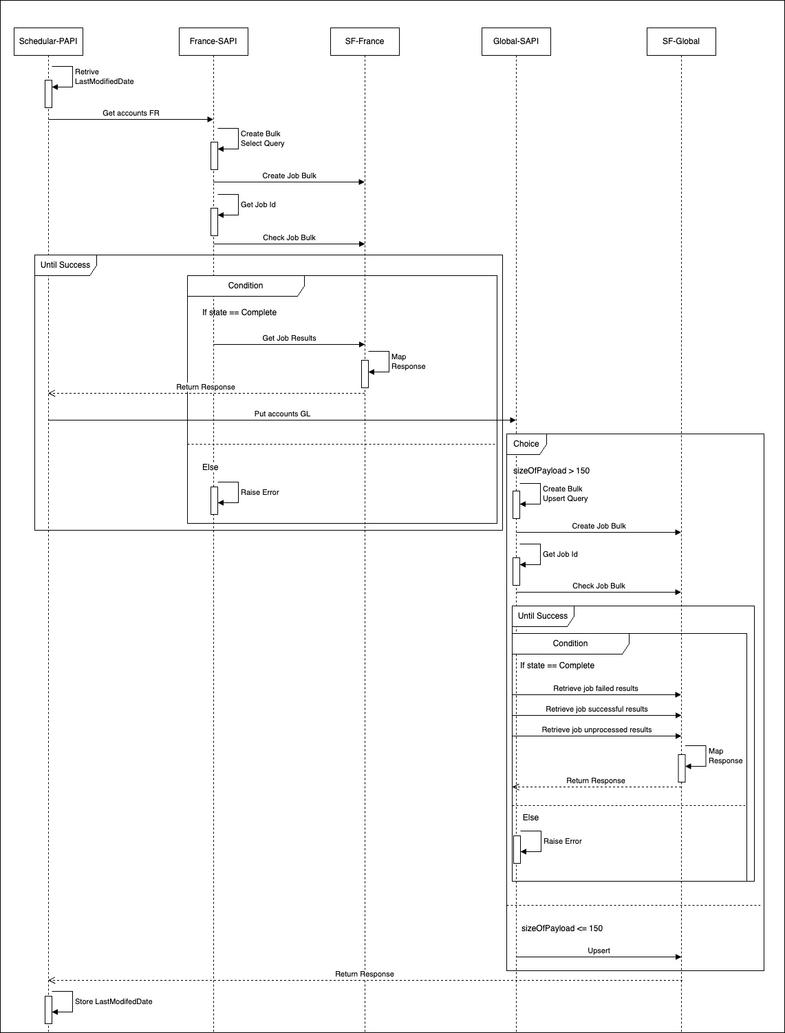
Sequence Diagram

Slide 20
Outils
Add flow

Slide 21
Template contents
Troubleshoot
Use case & Problematique
Architecture
Demo
Next Step

Slide 22
Template contents
Troubleshoot
Use case & Problematique
Architecture
Demo
Next Step

Slide 23
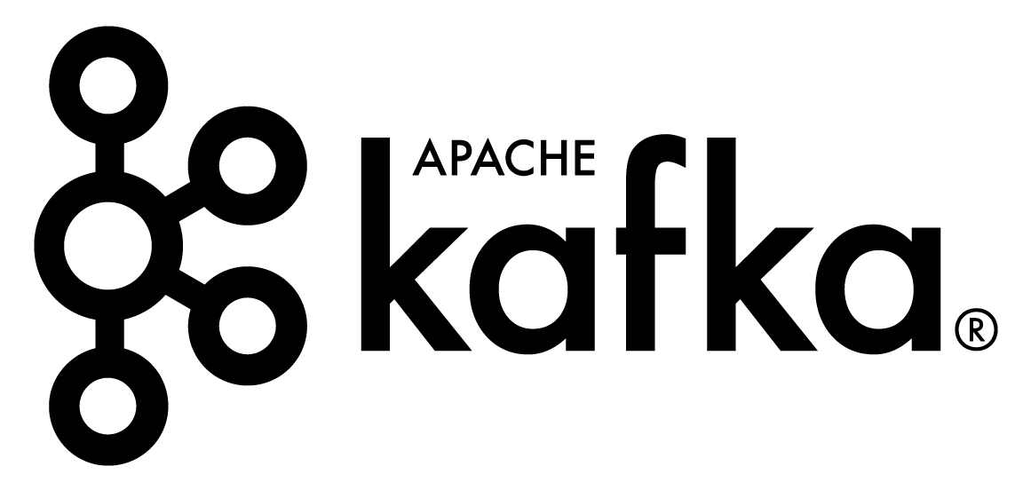
Future
Keys to Improve
Messaging Queues: Use tools like Kafka for efficient message handling.
Data Synchronization: Synchronize additional and more complex data (Contact, Cases…) .
Expand Connector Usage: Implement additional connectors such as publisher, listener, and Composite.
Optimize Archiving Model: Enhance the archiving model for increased efficiency and utility.

Slide 24
Salesforce Interview
Abdelbasset WARAKI

